Slide 1

Attention Is All You Need
Presented By
Madan Baduwal
Prakash Madai

Slide 2
Content
Problem
Introduction
Machine Learning
Dataset
Training
- Forward Pass
- Backward Pass
Inference
Deep learning
Dataset
Training
- Forward Pass
- Backward pass
Inference
Background
Existing ML, DL for language translation
Attention is all you need
Paper and Code

Slide 3
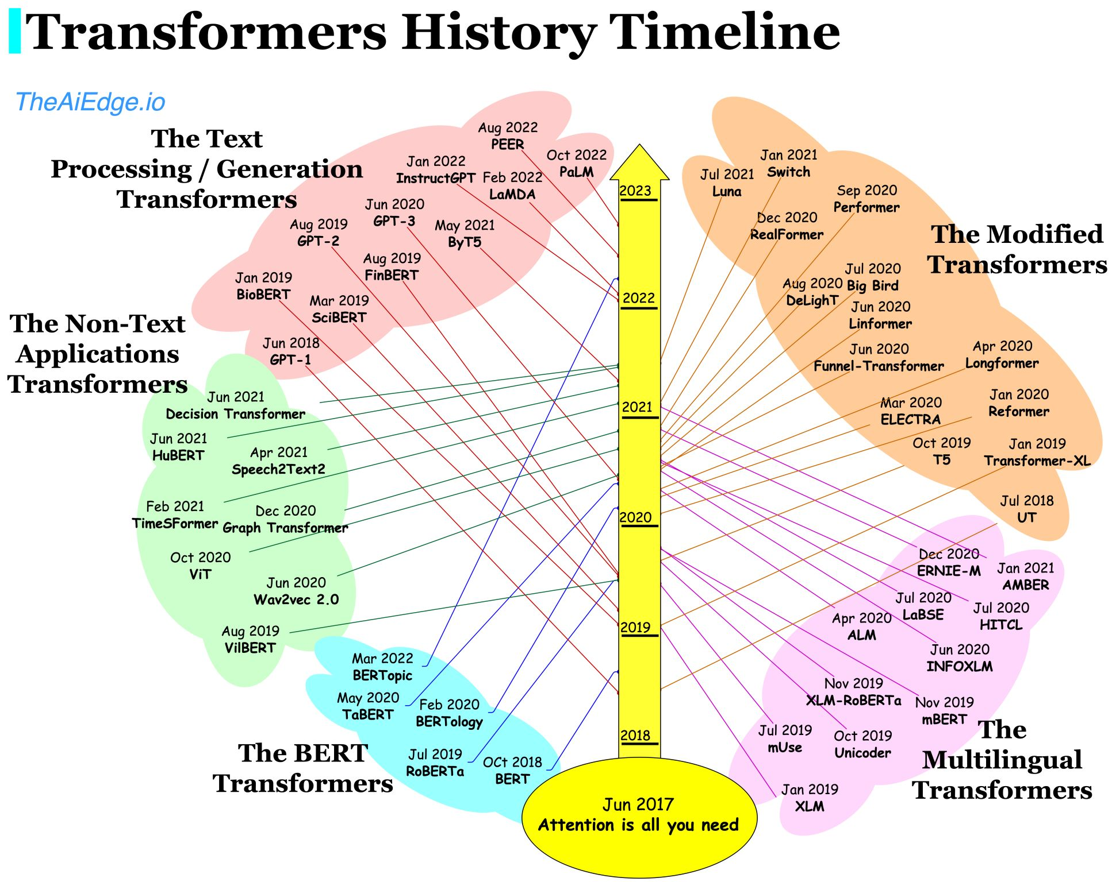
High Level Architecture of a Transformer

Slide 4
Problem

Slide 5

Problem: Language Translation

Slide 6
Machine Learning

Slide 7
Dataset
Height(inches) X | Weight(pound) Y
65 | 112
67 | 136
68 | 142
69 | 153
71 | 144

Slide 8
Forward Pass
Y = w*X+b
Height(inches) X | Weight(pound) Y
65 | 112
67 | 136
68 | 142
69 | 153
71 | 144
Weight(Y)
output
Height (X)
Input

Slide 9
Forward Pass
Y = 0.1*X+100
Randomly assign w and b
Height(inches) X | Weight(pound) Y
65 | 112
67 | 136
68 | 142
69 | 153
71 | 144
Weight(Y)
output
0.1
100
Height (X)
Input

Slide 10
Forward Pass
Y_p = 0.1*65+100 = 106.5
Prediction
Height(inches) X | Weight(pound) Y
65 | 112
67 | 136
68 | 142
69 | 153
71 | 144
Weight(Y)
output
0.1
100
Height (X)
Input

Slide 11
Forward Pass
Y_p = 0.1*65+100 = 106.5
Prediction
Height(inches) X | Weight(pound) Y
65 | 112
67 | 136
68 | 142
69 | 153
71 | 144
Weight(Y)
output
0.1
100
Height (X)
Input

Slide 12
Forward Pass
Y_p = 0.1*65+100 = 106.5
Prediction
Height(inches) X | Weight(pound) Y
65 | 112
67 | 136
68 | 142
69 | 153
71 | 144
Weight(Y)
output
0.1
100
Height (X)
Input

Slide 13
Backward Pass
Y_p = 0.1*65+100 = 106.5
e = 112-106.5
= 5.5
Height(inches) X | Weight(pound) Y
65 | 112
67 | 136
68 | 142
69 | 153
71 | 144
Weight(Y)
output
e
0.1
100
Height (X)
Input

Slide 14
Backward Pass
Y_p = 0.5*65+79.5 = 106.5
Update w and b
Height(inches) X | Weight(pound) Y
65 | 112
67 | 136
68 | 142
69 | 153
71 | 144
Weight(Y)
output
0.5
79.5
Height (X)
Input

Slide 15
Forward Pass
Y_p = 0.5*67+79.5 = 113
prediction
Height(inches) X | Weight(pound) Y
65 | 112
67 | 136
68 | 142
69 | 153
71 | 144
Weight(Y)
output
0.5
79.5
Height (X)
Input

Slide 16
Forward Pass
Y_p = 0.5*67+79.5 = 113
prediction
Height(inches) X | Weight(pound) Y
65 | 112
67 | 136
68 | 142
69 | 153
71 | 144
Weight(Y)
output
0.5
79.5
Height (X)
Input

Slide 17
Forward Pass
Y_p = 0.5*67+79.5 = 113
prediction
Height(inches) X | Weight(pound) Y
65 | 112
67 | 136
68 | 142
69 | 153
71 | 144
Weight(Y)
output
0.5
79.5
Height (X)
Input

Slide 18
Backward Pass
Y_p = 1*67+69 = 113
Update w and b
Height(inches) X | Weight(pound) Y
65 | 112
67 | 136
68 | 142
69 | 153
71 | 144
Weight(Y)
output
1
69
Height (X)
Input

Slide 19
Complete training with w=1 and b = 69
Y_p = 1*X+69
Final equation
Height(inches) X | Weight(pound) Y
65 | 112
67 | 136
68 | 142
69 | 153
71 | 144
Weight(Y)
output
1
69
Height (X)
Input

Slide 20
Inference
Y_p = 1*X+69
Inference
Height(inches) X | Weight(pound) Y
66 | ?
Weight(Y)
output
1
69
Height (X)
Input

Slide 21
Inference
Y_p = 1*66+69
Inference
Height(inches) X | Weight(pound) Y
66 | ?
Weight(Y)
output
1
69
Height (X)
Input

Slide 22
Inference
Y_p = 1*66+69
Inference
Height(inches) X | Weight(pound) Y
66 | ?
Weight(Y)
output
1
69
Height (X)
Input

Slide 23
Inference
Y_p = 1*66+69 = 135
Inference
Height(inches) X | Weight(pound) Y
66 | ?
Weight(Y)
output
1
69
Height (X)
Input

Slide 24
Inference
Y_p = 1*66+69 = 135
Inference
Height(inches) X | Weight(pound) Y
66 | 135
Weight(Y)
output
1
69
Height (X)
Input

Slide 25
Deep Learning

Slide 26
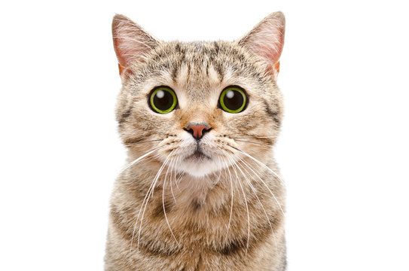
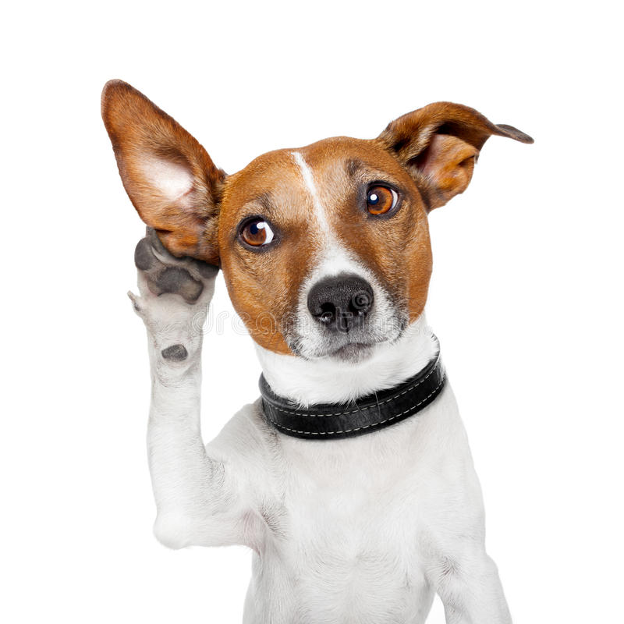
Dataset
pixels
1
3
0
5
Cat = 0
Cat = 1
X

Slide 27
Forward Pass
pixels
1
3
0
5
Cat = 0
Cat = 1
X
Input layer

Slide 28
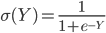
Forward Pass
Y= w * X + b ,
Single neuron
pixels
1
3
0
5
Cat = 0
Cat = 1
X
Input layer

Slide 29
Forward Pass
Randomly assign w and b
Y=[2 0.5 3 4] * + [ 4 ] ,
pixels
1
3
0
5
Cat = 0
Cat = 1
X
Input layer

Slide 30
Forward Pass
Randomly assign w and b
Y=[2 0.5 3 4] * + [ 4 ] ,
pixels
1
3
0
5
Cat = 0
Cat = 1
Input layer
Hidden layer
X

Slide 31
Forward Pass
Randomly assign w and b
Y=[2 0.5 3 4] * + [ 4 ] ,
pixels
1
3
0
5
Cat = 0
Cat = 1
Input layer
Hidden layer
Output layer
X

Slide 32
Forward Pass
Randomly assign w and b
Y=[2 0.5 3 4] * + [ 4 ] ,
pixels
1
3
0
5
Wrong Prediction
3
Cat = 0
Cat = 1
Input layer
Hidden layer
Output layer
X

Slide 33
Backward Pass
Randomly assign w and b
Y=[2 0.5 3 4] * + [ 4 ] ,
pixels
1
3
0
5
Calculate error
(0-3)
3
Cat = 0
Cat = 1
Input layer
Hidden layer
Output layer
X

Slide 34
Backward Pass
Update w and b
Y=[4 3 2 1] * + [ 0.5 ] ,
pixels
1
3
0
5
Cat = 0
Cat = 1
Input layer
Hidden layer
Output layer
X

Slide 35
Next Datapoints
Y=[4 3 2 5] * + [ 6 ] ,
pixels
1
3
0
5
Cat = 0
Cat = 1
Input layer
Hidden layer
Output layer
X

Slide 36
Complete training
learned parameters
Update w and b
Y=[4 3 2 5] * + [ 6 ] ,
pixels
1
3
0
5
Cat = 0
Cat = 1
Input layer
Hidden layer
Output layer
X

Slide 37
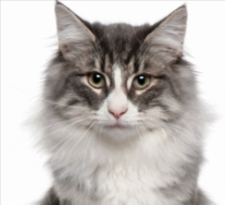
Inference
Update w and b
Y=[4 3 2 5] * + [ 6 ] ,
pixels
1
3
0
5
Input layer
Hidden layer
Output layer
X

Slide 38
Inference
Update w and b
Y=[4 3 2 5] * + [ 6 ] ,
pixels
1
3
0
5
Prediction ,0=cat
Input layer
Hidden layer
Output layer
X

Slide 39
Limitation of ANN,CNN
Independent outputs: Outputs are independent of previous outputs. Say, predicting dog doesn’t depend on the earlier prediction output, cat.

Slide 40
Next Word Prediction
Step 1:
Prof.Yan

Slide 41
Next Word Prediction
Step 1:
Prof.Yan
Step 2:
Prof.Yan
is

Slide 42
Next Word Prediction
Step 1:
Prof.Yan
Step 2:
Prof.Yan
is
Step 3:
Prof.Yan
is
a

Slide 43
Next Word Prediction
Step 1:
Prof.Yan
Step 2:
Prof.Yan
is
Step 3:
Prof.Yan
is
a
Step 4:
Prof.Yan
is
a
professor

Slide 44
Next Word Prediction
Step 1:
Prof.Yan
Step 2:
Prof.Yan
is
Step 3:
Prof.Yan
is
a
Step 4:
Prof.Yan
is
a
professor
Step 5:
Prof.Yan
is
a
professor
at

Slide 45
Next Word Prediction
Step 1:
Prof.Yan
Step 2:
Prof.Yan
is
Step 3:
Prof.Yan
is
a
Step 4:
Prof.Yan
is
a
professor
Step 5:
Prof.Yan
is
a
professor
at
Step 6:
Prof.Yan
is
a
professor
at
the

Slide 46
Next Word Prediction
Step 1:
Prof.Yan
Step 2:
Prof.Yan
is
Step 3:
Prof.Yan
is
a
Step 4:
Prof.Yan
is
a
professor
Step 5:
Prof.Yan
is
a
professor
at
Step 6:
Prof.Yan
is
a
professor
at
the
Step 7:
Prof.Yan
is
a
professor
at
the
UTPB

Slide 47
Next Word Prediction
Step 1:
Prof.Yan
Step 2:
Prof.Yan
is
Step 3:
Prof.Yan
is
a
Step 4:
Prof.Yan
is
a
professor
Step 5:
Prof.Yan
is
a
professor
at
Step 6:
Prof.Yan
is
a
professor
at
the
Step 7:
Prof.Yan
is
a
professor
at
the
UTPB
Step 8:
Prof.Yan
is
a
professor
at
the
UTPB
.

Slide 48
Recall limitation of CNN,ANN
Prof.Yan

Slide 49
Recall limitation of CNN,ANN
Prof.Yan
is

Slide 50
Recall limitation of CNN,ANN
Prof.Yan
is
a

Slide 51
Recall limitation of CNN,ANN
Prof.Yan
is
a

Slide 52
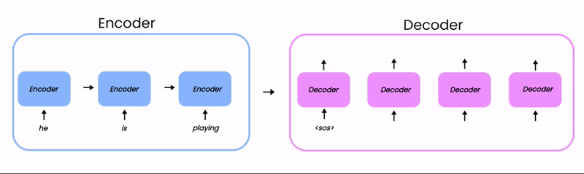
Introduction
Existing Algorithms: Sequence Models(LSTM,GRU)

Slide 53
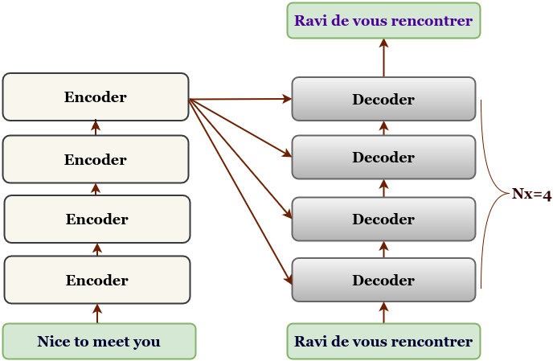
Transformer is a stack of encoder and decoder layers.
Notes:
Also to add, the Transformer architecture consists of multiple layers of encoder and decoder stacks. The encoder or decoder layers are repeated for Nx times. The encoded part of a transformer network is transferred to the decoder layer from the top-most encoder layer.

Slide 54
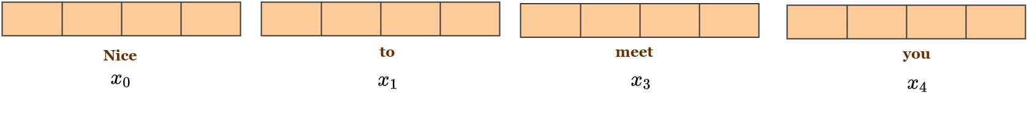
Input/Output embeddings are the combination of word embeddings and positional embedding.
Word embeddings

Slide 55
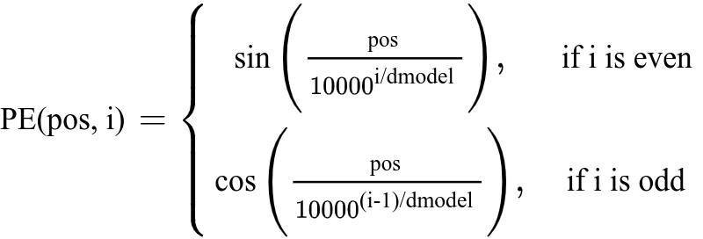
Input/Output embeddings are the combination of word embeddings and positional embedding.
Positional embeddings

Slide 56
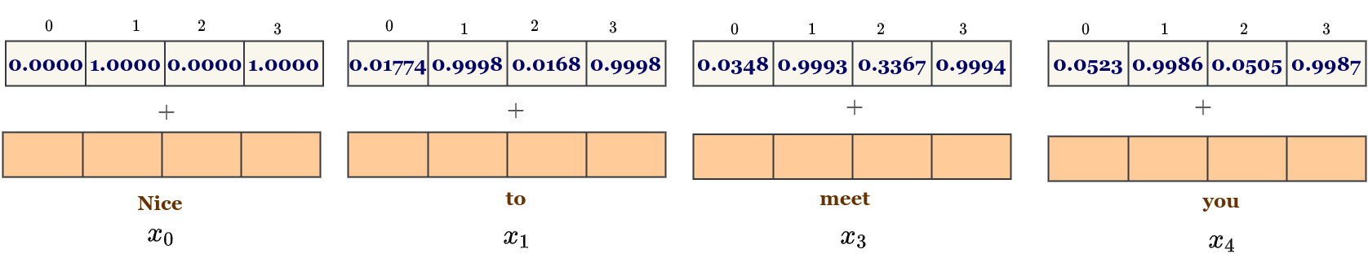
Input/Output embeddings are the combination of word embeddings and positional embedding.
Positional Embeddings

Slide 57
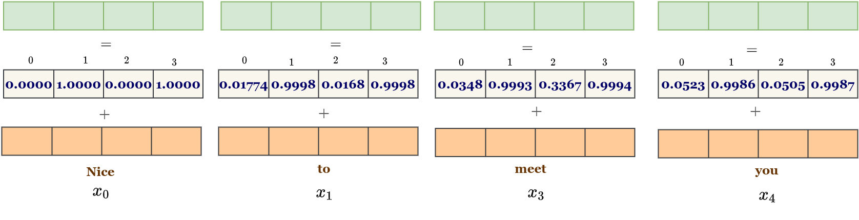
Input/Output embeddings are the combination of word embeddings and positional embedding.
Input/Output Embeddings

Slide 58

Query, Key and Values Intuition

Slide 59
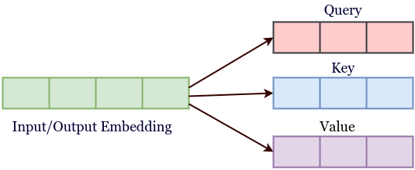
Query, Key and Value in a Transformer Network
Notes:
In a Transformer network, each word have it's corresponding key, query and a value associated with it. Key, query and value are all vectors and are learnt during the training process. It can be thought of as separating a word vector into three separate vectors.

Slide 60
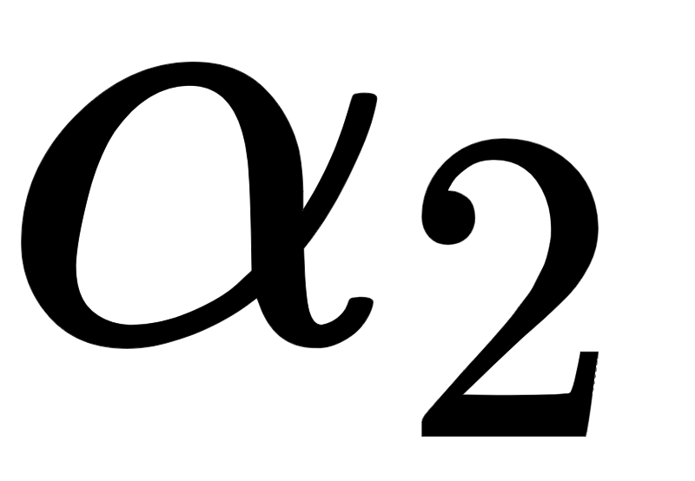
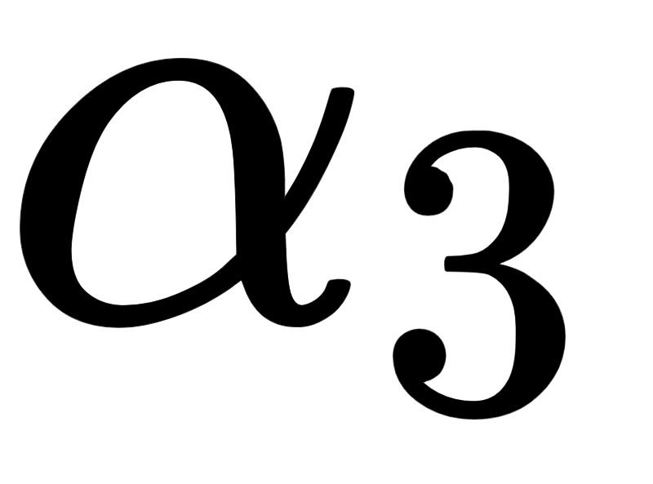
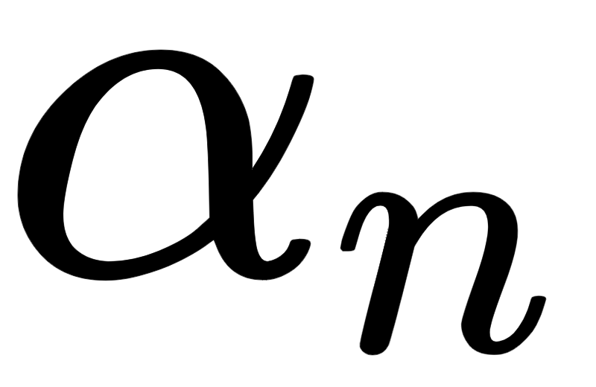
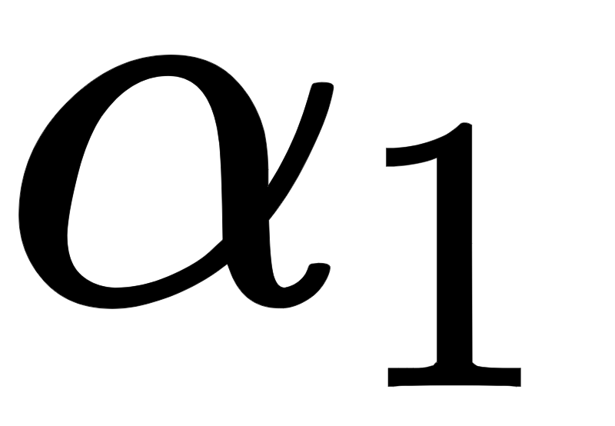
Attention is the weighted sum of values where the weights assigned to each value is the similarity score between the query and the key.
….
….
Key 1
Key 2
Key 3
Key n
Query
Attention Value
Value 1
Value 2
Value 3
Value n
Notes:
Now let’s understand the attention mechanism with the concepts of key, query and values. Suppose we have following key and value pairs.
And we want to match a query to these keys. [click]
Suppose alpha 1 is the similarity score between query and key 1. [click]
Then, it is matched with key 2, suppose in this case the similarity score is alpha 2. [click]
Similary we do this upto all the available keys. [click] [click]
The attention value is computed as the weighted sum of all the values. [click] [click]

Slide 61
Self attention is the attention between each of the words in the input or the target words.
The
The
The
The
animal
animal
animal
animal
didn’t
didn’t
didn’t
didn’t
cross
cross
cross
cross
the
the
the
the
street
street
street
street
because
because
because
because
it
it
it
it
was
was
was
was
too
too
too
too
wide
wide
tired
tired
.
.
.
.
Notes:
Self attention is the attention between each of the words in the input or the target words. Let’s consider a particular example. Suppose we have the sentence “the animal didn’t cross the street because it was too wide.” Here the word “it” refers to the the word “street”. So the self attention mechanism gives much importance to the word “street”. However, the words such are “the”, “animal”, “it” and “full-stop” are also somehow likely to be related to it, the self attention considers these words with less weights or importance.
[click]
Similarly in the second example the word “it” refers to the word “animal” as animal is being tired so it is not crossing the street. The self attention gives much attention to the word “animal” followed by other words.

Slide 62
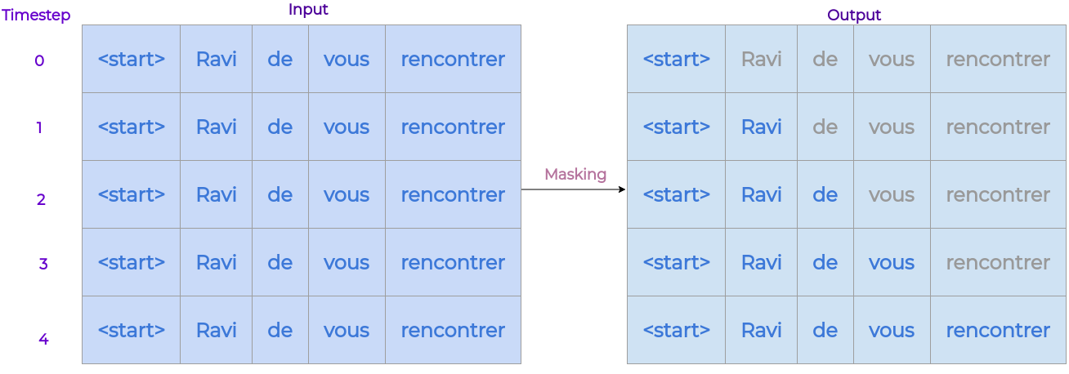
Masking inputs at decoder to restrict the model to receive future words.

Slide 63
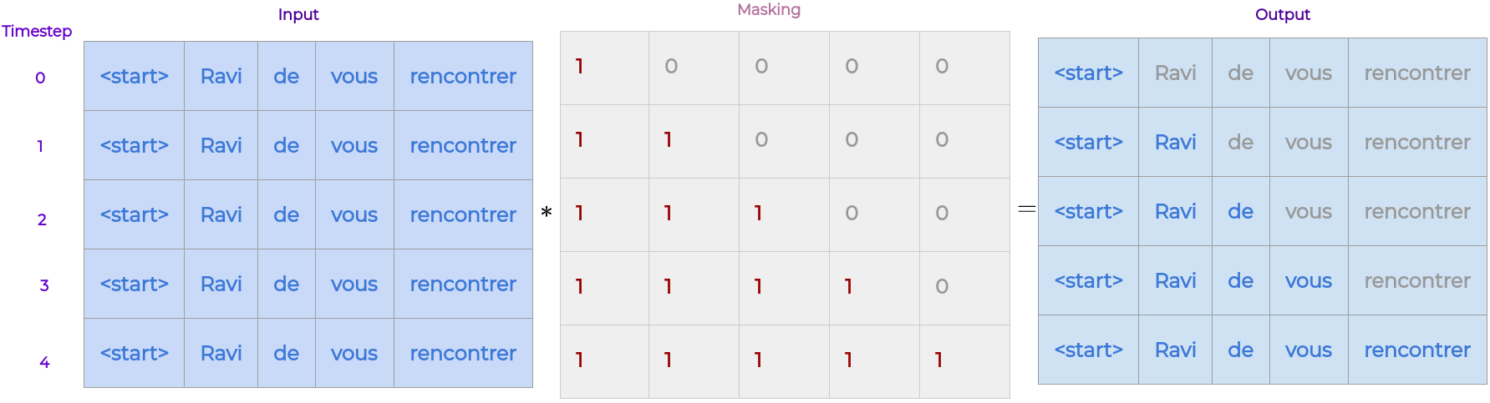
Masking inputs at decoder to restrict the model to receive future words.

Slide 64
Overall process in a transformer
Nice
to
meet
you
Ravi
de
vous
rencontrer
Encoder
Decoder

Slide 65
Nice
to
meet
you
Ravi
Ravi
de
vous
recontrer
rencontrer
Encoder 1
Decoder

Slide 66
Nice
to
meet
you
Ravi
Ravi
de
vous
recontrer
rencontrer
Encoder 1
Decoder

Slide 67
Nice
to
meet
you
Ravi
Ravi
de
vous
recontrer
rencontrer
Encoder 1
Decoder

Slide 68
Nice
to
meet
you
Ravi
Ravi
de
vous
recontrer
rencontrer
Encoder 1
Decoder
Notes:
[click]

Slide 69
Nice
to
meet
you
Ravi
Ravi
de
vous
recontrer
rencontrer
Encoder 1
Decoder
Notes:
[click]

Slide 70
Nice
to
meet
you
Ravi
Ravi
de
vous
recontrer
rencontrer
Encoder 1
Decoder

Slide 71
Nice
to
meet
you
Ravi
Ravi
de
vous
recontrer
rencontrer
Encoder 2
Decoder

Slide 72
Nice
to
meet
you
Ravi
Ravi
de
vous
recontrer
rencontrer
Encoder 2
Decoder
Notes:
[click]

Slide 73
Nice
to
meet
you
Ravi
Ravi
de
vous
recontrer
rencontrer
Encoder 2
Decoder
Notes:
[click]

Slide 74
Nice
to
meet
you
Ravi
Ravi
de
vous
recontrer
rencontrer
Encoder 2
Decoder
Notes:
[click]

Slide 75
Nice
to
meet
you
Ravi
Ravi
de
vous
recontrer
rencontrer
Encoder 2
Decoder
Notes:
[click]

Slide 76
Nice
to
meet
you
Ravi
Ravi
de
vous
recontrer
rencontrer
Encoder 2
Decoder
Notes:
[click]

Slide 77
Nice
to
meet
you
Ravi
Ravi
de
vous
recontrer
rencontrer
Encoder 3
Decoder
Notes:
Similary we perfom the same operations in the third encoder as well.

Slide 78
Nice
to
meet
you
Ravi
Ravi
de
vous
recontrer
rencontrer
Encoder 3
Decoder
Notes:
[click]

Slide 79
Nice
to
meet
you
Ravi
Ravi
de
vous
recontrer
rencontrer
Encoder 3
Decoder
Notes:
[click]

Slide 80
Nice
to
meet
you
Ravi
Ravi
de
vous
recontrer
rencontrer
Encoder 3
Decoder
Notes:
[click]

Slide 81
Nice
to
meet
you
Ravi
Ravi
de
vous
recontrer
rencontrer
Encoder 3
Decoder
Notes:
[click]

Slide 82
Nice
to
meet
you
Ravi
Ravi
de
vous
recontrer
rencontrer
Encoder 3
Decoder
Notes:
Similary we perfom the same operations in the third encoder as well.

Slide 83
Decoding Time-step 1
Nice
to
meet
you
Ravi
de
vous
recontrer
rencontrer
Encoder
Decoder
Notes:
Now it’s is time to decode the source sentences. We unmask the first word of the target.

Slide 84
Decoding Time-step 1
Nice
to
meet
you
Ravi
de
vous
recontrer
rencontrer
Encoder
Decoder 1 Masked Self Attention
Notes:
Then we perform the self attention on this word alone.

Slide 85
Decoding Time-step 1
Nice
to
meet
you
Ravi
de
vous
recontrer
rencontrer
Encoder
Encoder-Decoder 1 Attention
Notes:
Then we perform encoder and decoder attention.

Slide 86
Decoding Time-step 1
Nice
to
meet
you
Ravi
de
vous
recontrer
rencontrer
Encoder
Encoder
Decoder 1 Masked Self Attention
Decoder Masked Self Attn 2
Notes:
This goes for all three decoder layers.

Slide 87
Decoding Time-step 1
Nice
to
meet
you
Ravi
de
vous
recontrer
rencontrer
Encoder
Encoder-Decoder 2 Attention
Notes:
[click]

Slide 88
Decoding Time-step 1
Nice
to
meet
you
Ravi
de
vous
recontrer
rencontrer
Encoder
Encoder
Decoder 1 Masked Self Attention
Decoder Masked Self Attn 3
Notes:
[click]

Slide 89
Decoding Time-step 1
Nice
to
meet
you
Ravi
de
vous
recontrer
rencontrer
Encoder
Encoder-Decoder 3 Attention
Notes:
[click]

Slide 90
de
Linear + Softmax
Nice
to
meet
you
Ravi
de
vous
recontrer
rencontrer
Encoder
Decoder
Notes:
Now it is passed through Linear plus softmax layer, where it gives the predicted word which is “de”.

Slide 91
Decoding Time-step 2
Nice
to
meet
you
Ravi
de
vous
recontrer
rencontrer
Encoder
Decoder 1 Masked Self Attention
Notes:
Now in decoder layer we unmask the second word which is “de”. Now the goal of the transformer is to predict the next word which is “vous”.

Slide 92
Decoding Time-step 2
Nice
to
meet
you
Ravi
de
vous
recontrer
rencontrer
Encoder
Decoder 1 Masked Self Attention
Notes:
We perform self attention followed by encoder-decoder attention in all three layers.

Slide 93
Decoding Time-step 2
Nice
to
meet
you
Ravi
de
vous
recontrer
rencontrer
Encoder
Encoder-Decoder 1 Attention
Notes:
[click]

Slide 94
Decoding Time-step 2
Nice
to
meet
you
Ravi
de
vous
recontrer
rencontrer
Encoder
Decoder 2 Masked Self Attention
Notes:
[click]

Slide 95
Decoding Time-step 2
Nice
to
meet
you
Ravi
de
vous
recontrer
rencontrer
Encoder
Encoder-Decoder 2 Attention
Notes:
[click]

Slide 96
Decoding Time-step 2
Nice
to
meet
you
Ravi
de
vous
recontrer
rencontrer
Encoder
Decoder 3 Masked Self Attention
Notes:
[click]

Slide 97
Decoding Time-step 2
Nice
to
meet
you
Ravi
de
vous
recontrer
rencontrer
Encoder
Encoder-Decoder 3 Attention
Notes:
[click]

Slide 98
vous
Linear + Softmax
Nice
to
meet
you
Ravi
de
vous
recontrer
rencontrer
Encoder
Decoder
Notes:
And we get the final output. The similar process repeated for remaining words until we get to the end of sentence.

Slide 99
Decoding Time-step 3
Nice
to
meet
you
Ravi
de
vous
recontrer
rencontrer
Encoder
Decoder 1 Masked Self Attention
Notes:
[click]

Slide 100
Decoding Time-step 3
Nice
to
meet
you
Ravi
de
vous
recontrer
rencontrer
Encoder
Decoder 1 Masked Self Attention
Notes:
[click]

Slide 101
Decoding Time-step 3
Nice
to
meet
you
Ravi
de
vous
recontrer
rencontrer
Encoder
Encoder-Decoder 1 Attention
Notes:
[click]

Slide 102
Decoding Time-step 3
Nice
to
meet
you
Ravi
de
vous
recontrer
rencontrer
Encoder
Decoder 2 Masked Self Attention
Notes:
[click]

Slide 103
Decoding Time-step 3
Nice
to
meet
you
Ravi
de
vous
recontrer
rencontrer
Encoder
Encoder-Decoder 2 Attention
Notes:
[click]

Slide 104
Decoding Time-step 3
Nice
to
meet
you
Ravi
de
vous
recontrer
rencontrer
Encoder
Decoder 3 Masked Self Attention
Notes:
[click]

Slide 105
Decoding Time-step 3
Nice
to
meet
you
Ravi
de
vous
recontrer
rencontrer
Encoder
Encoder-Decoder 3 Attention
Notes:
[click]

Slide 106
rencontrer
Linear + Softmax
Nice
to
meet
you
Ravi
de
vous
recontrer
rencontrer
Encoder
Decoder
Notes:
[click]

Slide 107
Decoding Time-step 4
Nice
to
meet
you
Ravi
de
vous
rencontrer
Encoder
Decoder 1 Masked Self Attention
Notes:
[click]

Slide 108
Decoding Time-step 4
Nice
to
meet
you
Ravi
de
vous
rencontrer
Encoder
Decoder 1 Masked Self Attention

Slide 109
Decoding Time-step 4
Nice
to
meet
you
Ravi
de
vous
rencontrer
Encoder
Encoder-Decoder 1 Attention
Notes:
[click]

Slide 110
Decoding Time-step 4
Nice
to
meet
you
Ravi
de
vous
rencontrer
Encoder
Decoder 2 Masked Self Attention
Notes:
[click]

Slide 111
Decoding Time-step 3
Decoding Time-step 4
Nice
to
meet
you
Ravi
de
vous
recontrer
rencontrer
Encoder
Encoder-Decoder 2 Attention
Notes:
[click]

Slide 112
Decoding Time-step 4
Nice
to
meet
you
Ravi
de
vous
recontrer
rencontrer
Encoder
Decoder 3 Masked Self Attention

Slide 113
Decoding Time-step 4
Nice
to
meet
you
Ravi
de
vous
recontrer
rencontrer
Encoder
Encoder-Decoder 3 Attention
Notes:
[click]

Slide 114
<eos>
Linear + Softmax
Nice
to
meet
you
Ravi
de
vous
recontrer
rencontrer
Encoder
Decoder

Slide 115
Paper and code
Paper link
Code link

